Slide 1
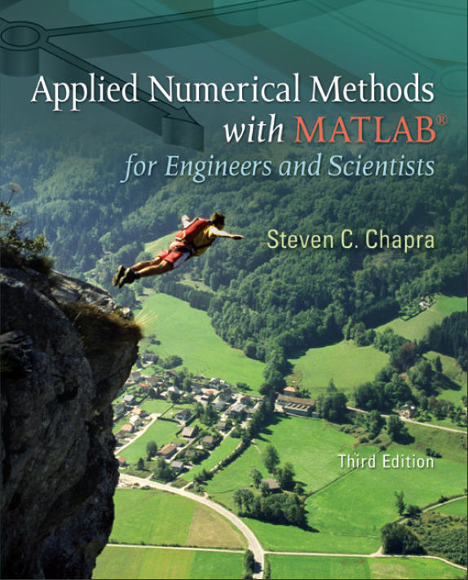
Part 3
Chapter 9
Gauss Elimination
PowerPoints organized by Dr. Michael R. Gustafson II, Duke University
All images copyright © The McGraw-Hill Companies, Inc. Permission required for reproduction or display.

Slide 2
Chapter Objectives
Knowing how to solve small sets of linear equations with the graphical method and Cramer’s rule.
Understanding how to implement forward elimination and back substitution as in Gauss elimination.
Understanding how to count flops to evaluate the efficiency of an algorithm.
Understanding the concepts of singularity and ill-condition.
Understanding how partial pivoting is implemented and how it differs from complete pivoting.
Recognizing how the banded structure of a tridiagonal system can be exploited to obtain extremely efficient solutions.

Slide 3
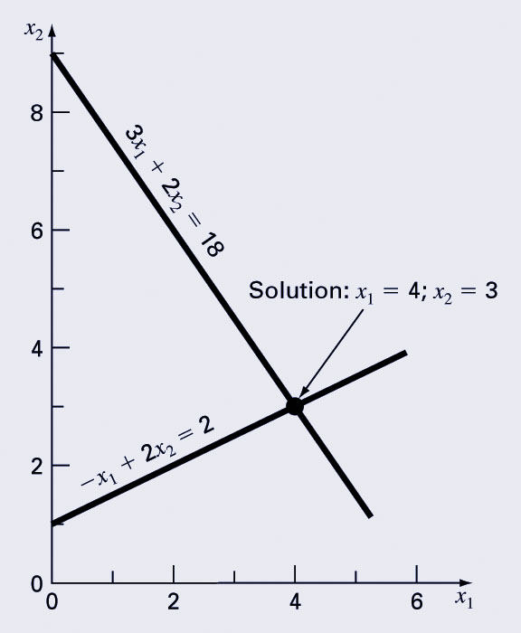
Graphical Method
For small sets of simultaneous equations, graphing them and determining the location of the intercept provides a solution.

Slide 4
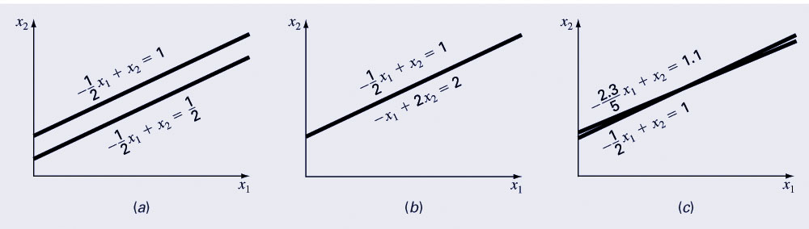
Graphical Method (cont)
Graphing the equations can also show systems where:
  No solution exists
  Infinite solutions exist
  System is ill-conditioned

Slide 5
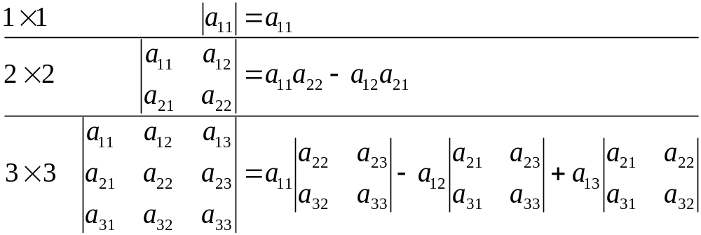
Determinants
The determinant D=|A| of a matrix is formed from the coefficients of [A].
Determinants for small matrices are:
Determinants for matrices larger than 3 x 3 can be very complicated.

Slide 6
Cramer’s Rule
Cramer’s Rule states that each unknown in a system of linear algebraic equations may be expressed as a fraction of two determinants with denominator D and with the numerator obtained from D by replacing the column of coefficients of the unknown in question by the constants b₁, b₂, …, b_{n}.

Slide 7
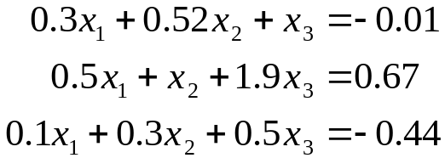
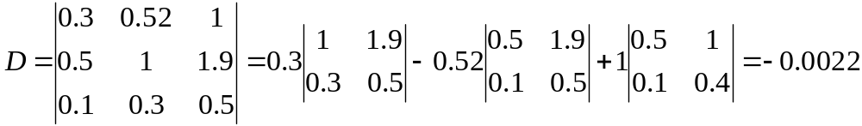
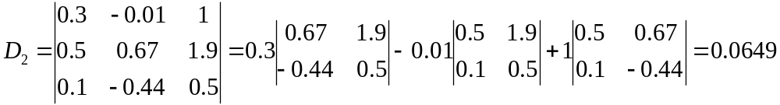
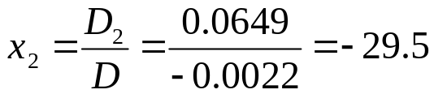
Cramer’s Rule Example
Find x₂ in the following system of equations:
Find the determinant D
Find determinant D₂ by replacing D’s second column with b
Divide

Slide 8
Naïve Gauss Elimination
For larger systems, Cramer’s Rule can become unwieldy.
Instead, a sequential process of removing unknowns from equations using forward elimination followed by back substitution may be used - this is Gauss elimination.
“Naïve” Gauss elimination simply means the process does not check for potential problems resulting from division by zero.

Slide 9
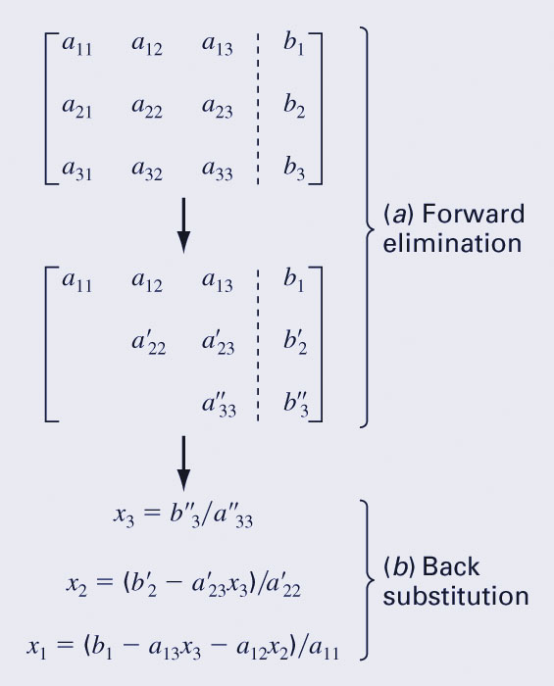
Naïve Gauss Elimination (cont)
Forward elimination
  Starting with the first row, add or subtract multiples of that row to eliminate the first coefficient from the second row and beyond.
  Continue this process with the second row to remove the second coefficient from the third row and beyond.
  Stop when an upper triangular matrix remains.
Back substitution
  Starting with the last row, solve for the unknown, then substitute that value into the next highest row.
  Because of the upper-triangular nature of the matrix, each row will contain only one more unknown.

Slide 10
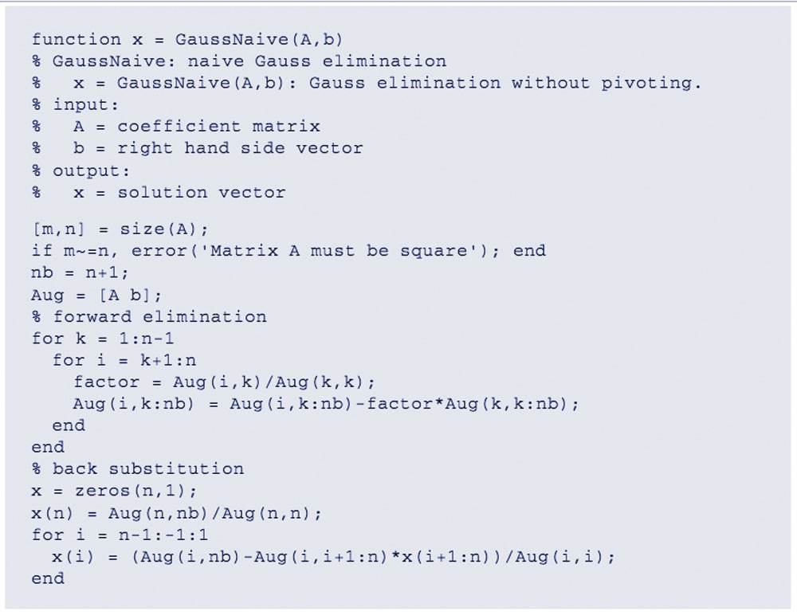
Naïve Gauss Elimination Program

Slide 11
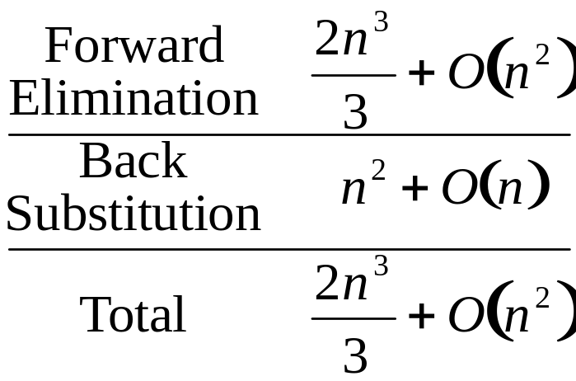
Gauss Program Efficiency
The execution of Gauss elimination depends on the amount of floating-point operations (or flops). The flop count for an n x n system is:
Conclusions:
  As the system gets larger, the computation time increases greatly.
  Most of the effort is incurred in the elimination step.

Slide 12
Pivoting
Problems arise with naïve Gauss elimination if a coefficient along the diagonal is 0 (problem: division by 0) or close to 0 (problem: round-off error)
One way to combat these issues is to determine the coefficient with the largest absolute value in the column below the pivot element. The rows can then be switched so that the largest element is the pivot element. This is called partial pivoting.
If the rows to the right of the pivot element are also checked and columns switched, this is called complete pivoting.

Slide 13
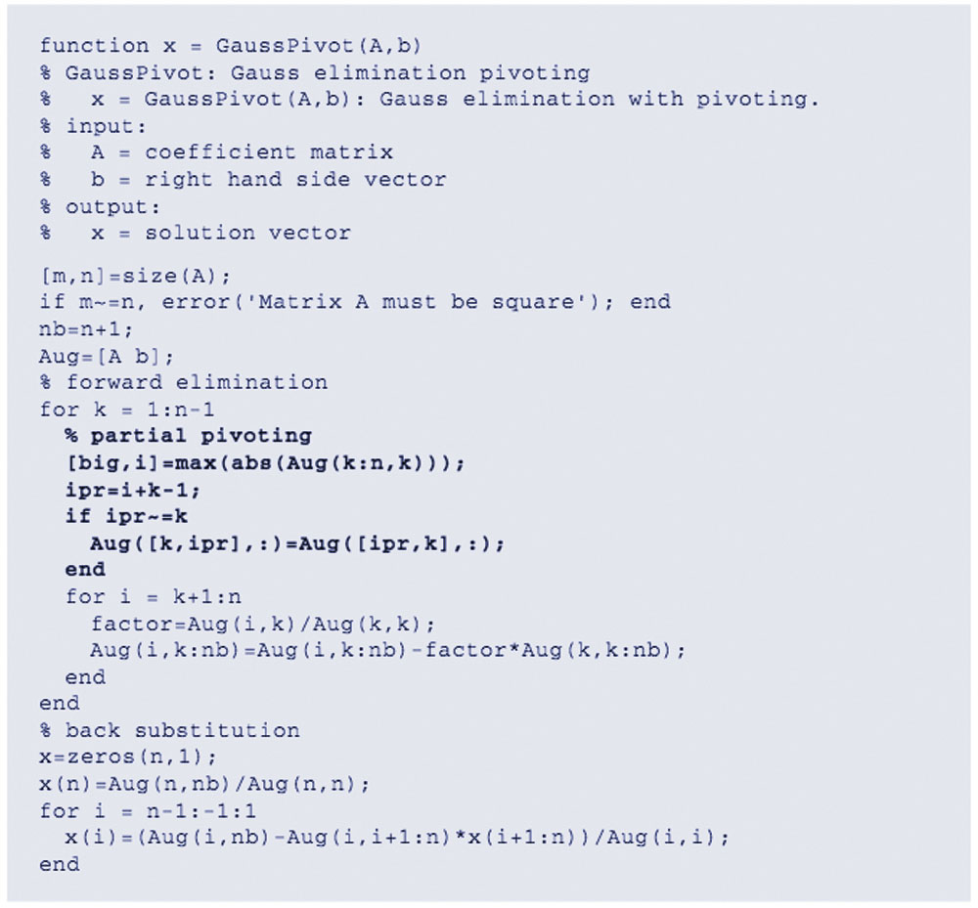
Partial Pivoting Program

Slide 14
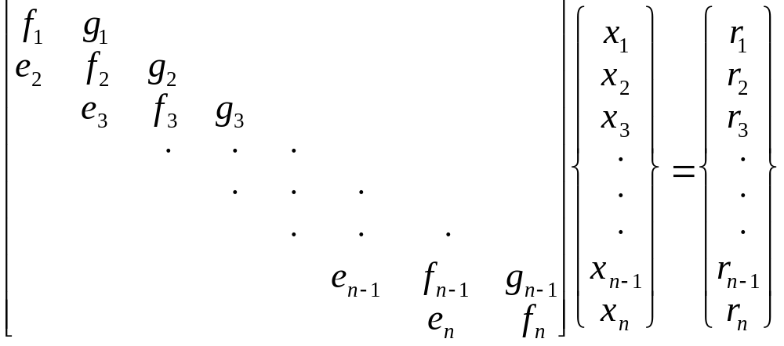
Tridiagonal Systems
A tridiagonal system is a banded system with a bandwidth of 3:
Tridiagonal systems can be solved using the same method as Gauss elimination, but with much less effort because most of the matrix elements are already 0.

Slide 15
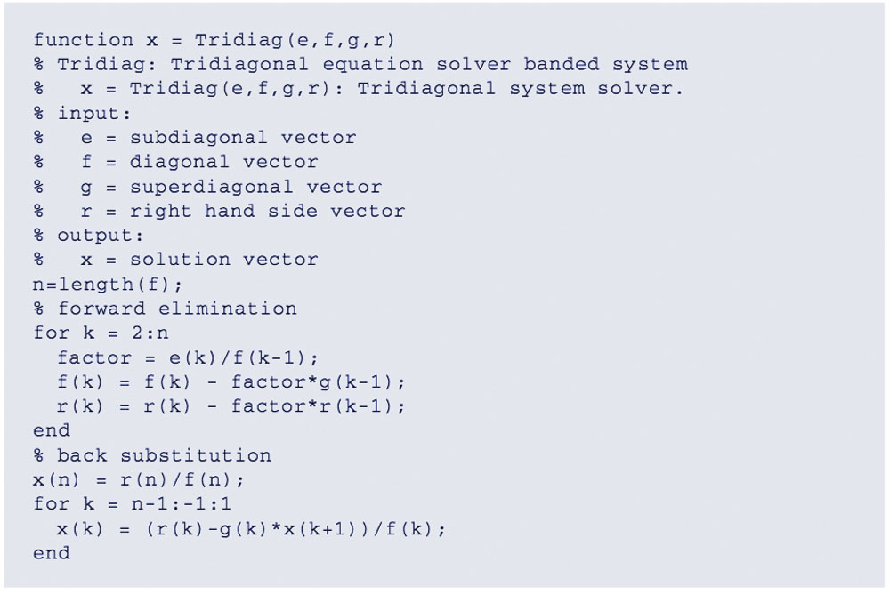
Tridiagonal System Solver

Slide 16
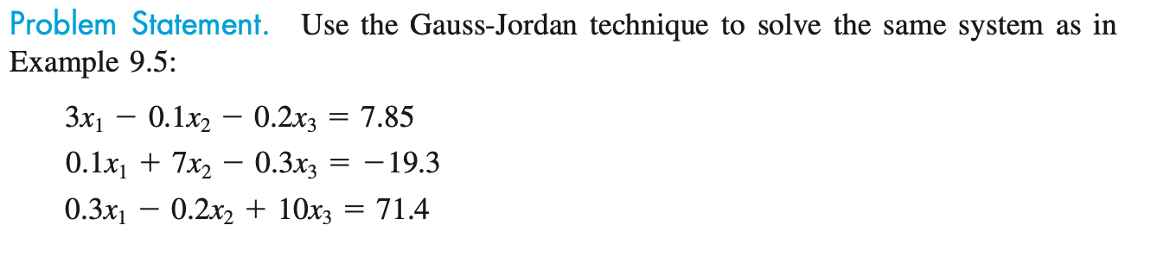
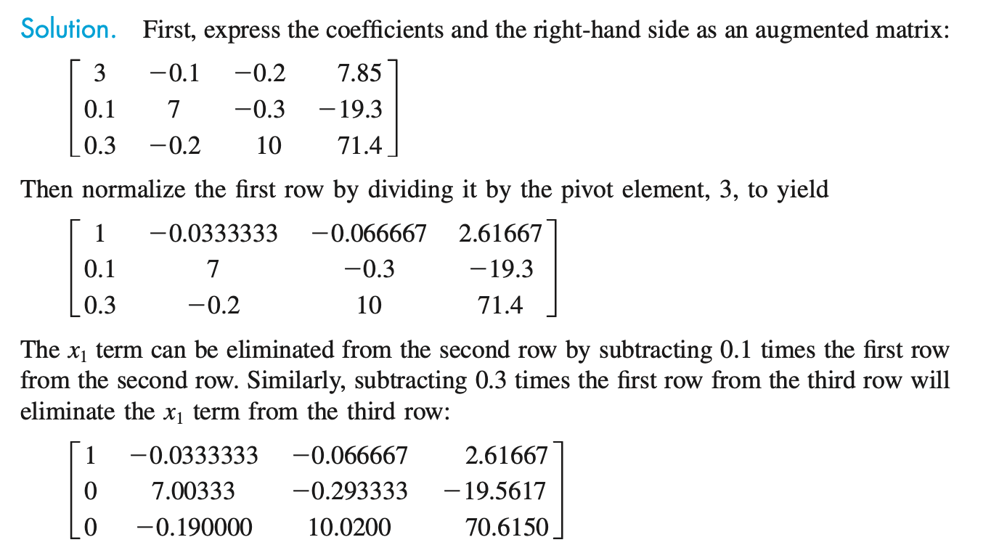
Gauss-Jordan

Slide 17
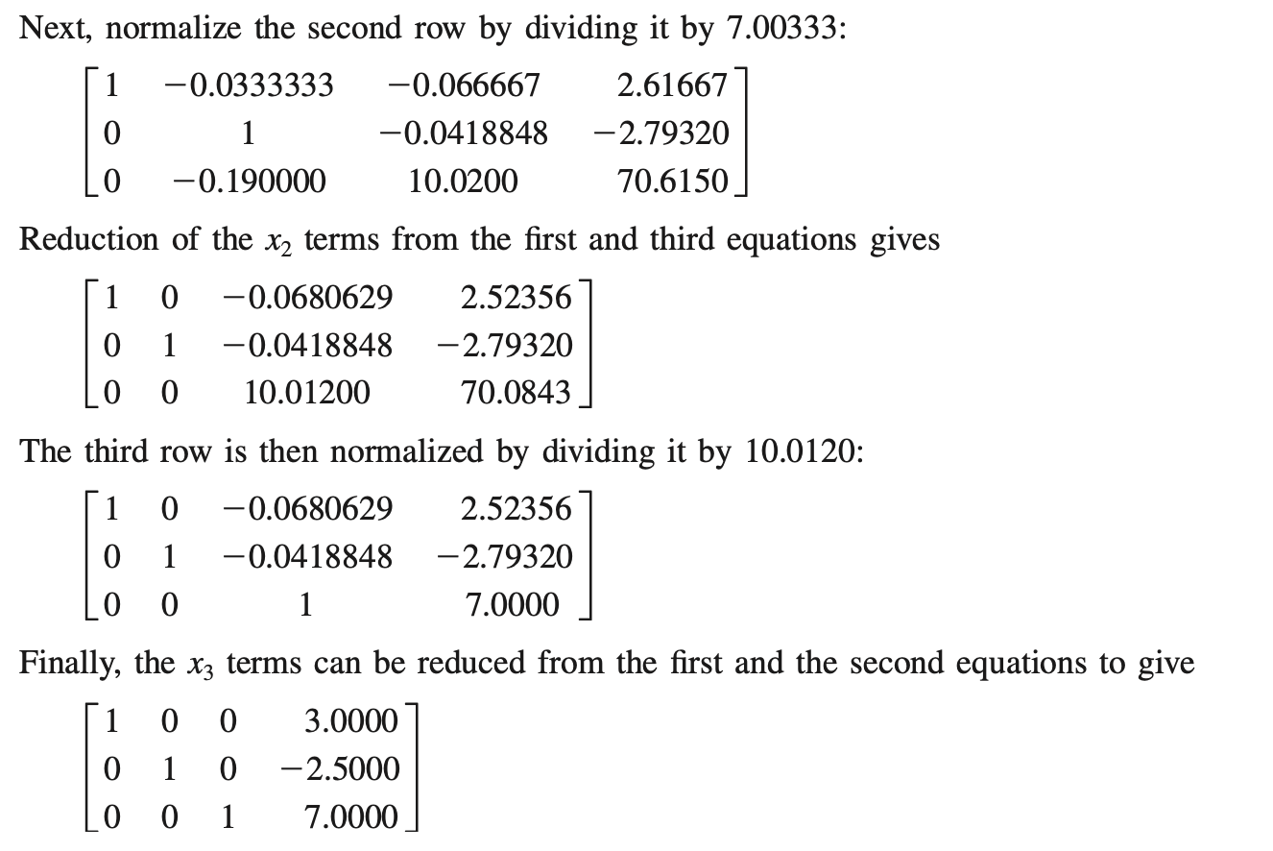
Gauss-Jordan

